Slide 1

Exploring the Subgraph Density-Size Trade-off via the Lovasz Extension
Aritra Konar
and
Nicholas D. Sidiropoulos
Department of Electrical and Computer Engineering
WSDM 2021, Virtual Event

Slide 2
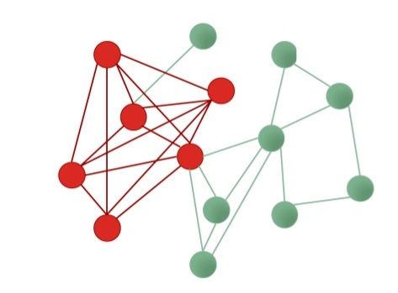
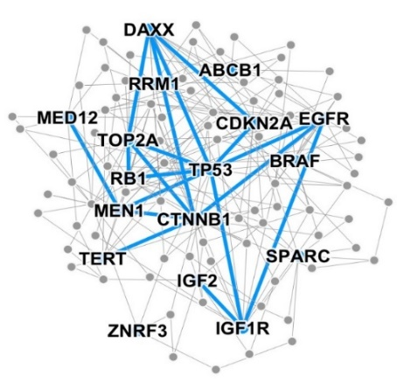
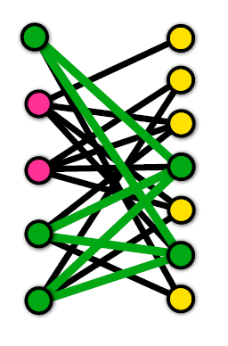
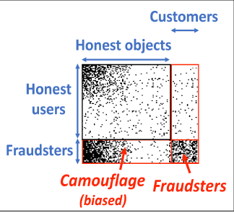
Dense Subgraph Discovery
Problem: Given a graph, find list of “dense’’ subgraphs
A key primitive in graph mining
Applications:
Detecting correlated genes
[Tsourakakis et al. 2013]
Anomaly detection in e-commerce
and social networks [Hooi et al. 2016]
Story identification in Twitter streams [Angel et al. 2012]

Slide 3
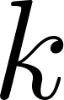
What is a dense subgraph?
Archetype: Cliques
NP-hard, restrictive definition
Densest subgraph:
Find subgraph with maximum average induced degree
Polynomial-time algorithms [Goldberg 1984, Charikar 2000]
Does not allow explicit control of subgraph size
Densest-k-subgraph (DkS):
Find subgraph of size with maximum number of edges
Can be used to explore the subgraph density-size curve

Slide 4
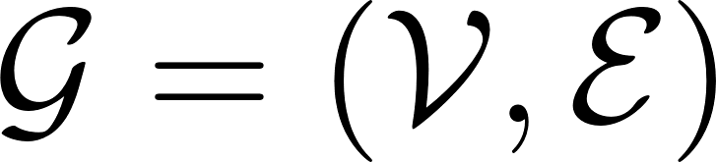
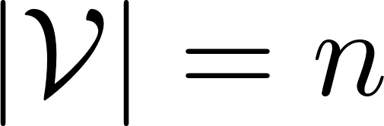
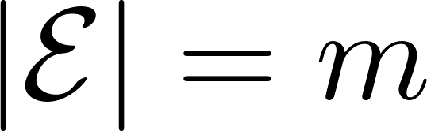
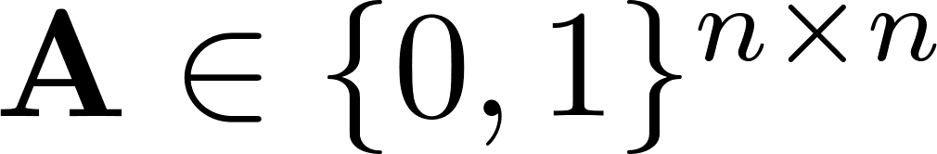
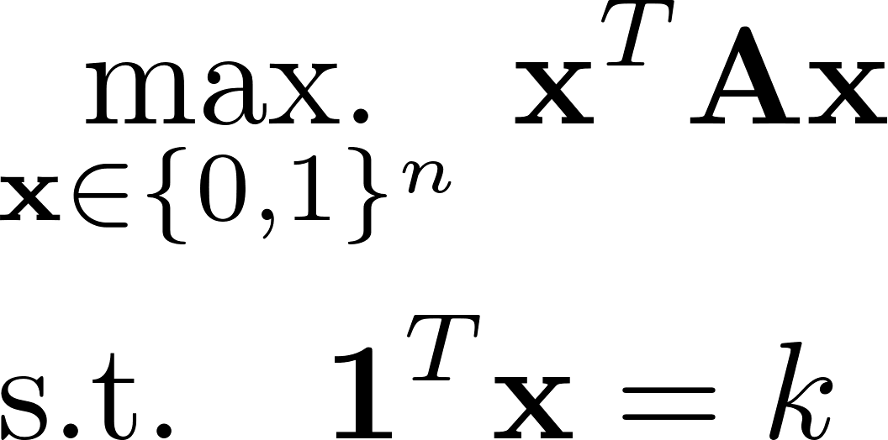
DkS: Formulation
Input: An undirected graph
vertices
edges
Represented using (binary) adjacency matrix
Desired subgraph size
Formulation:
Combinatorial quadratic programming problem
NP-hard
reduction from maximum-clique [Feige et al. 2001]

Slide 5
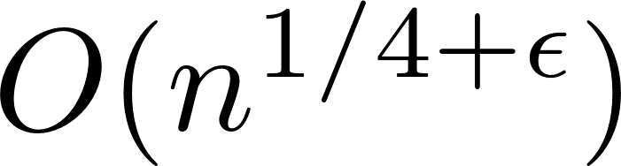
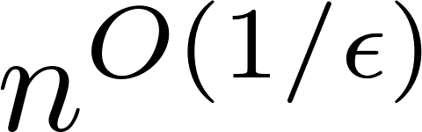
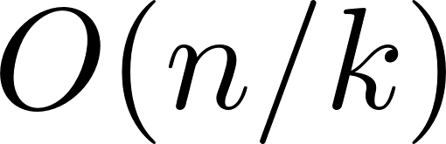
DkS: Prior Art
Notoriously difficult to approximate [Khot 2006, Bhaskara et al. 2012]
State-of-the-art result: [Bhaskara et al. 2010]
Yields approximation guarantee in time
Other methods:
Greedy algorithm: fast, guarantee [Feige et al. 2001]
Semidefinite relaxation:
Provides guarantee [Srivastav-Wolf 1998, Feige-Langberg 2001]
Exact recovery in synthetic planted model [Bombina-Ames 2020]
Computationally expensive
Low-rank matrix approximation: [Papailiopoulos et al. 2014]
Solve DkS with low (constant) rank approximation of adjacency matrix
Provides data-dependent guarantees, works well in practice

Slide 6
Our contributions
New convex relaxation for DkS
Cost function of DkS is a submodular function
Use the Lovasz extension [Lovasz 1983] as a convex surrogate
A scalable algorithm for solving the relaxed problem at scale
Variant of the Alternating Direction Method of Multipliers (ADMM) [Lions-Mercier 1979, Eckstein-Bertsekas 1992, Boyd et al. 2011, Condat 2014]
Attains state-of-the-art performance on real-world graphs
Provably no worse than 65-80% of optimal edge density

Slide 7
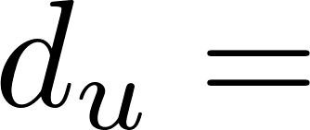

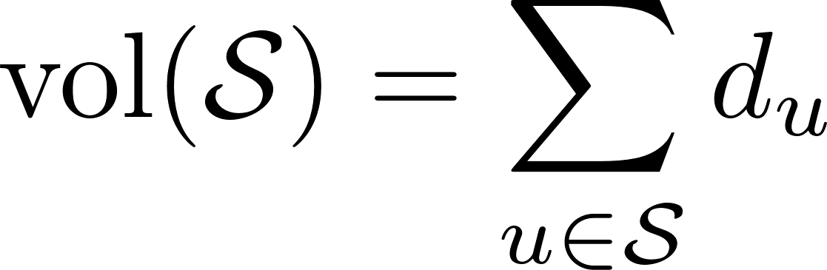

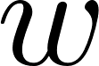
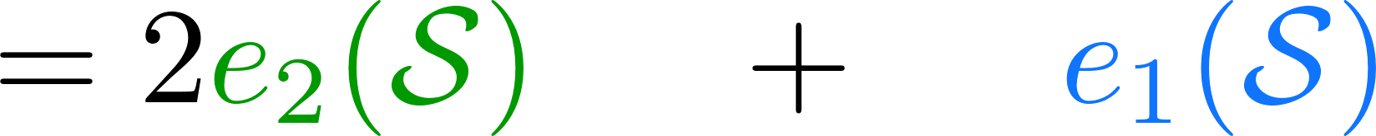

New relaxation: Main idea
Notation: degree of vertex
Re-arranging:
# edges with 2 endpoints in
# edges with 1 endpoint in
Equivalently

Slide 8
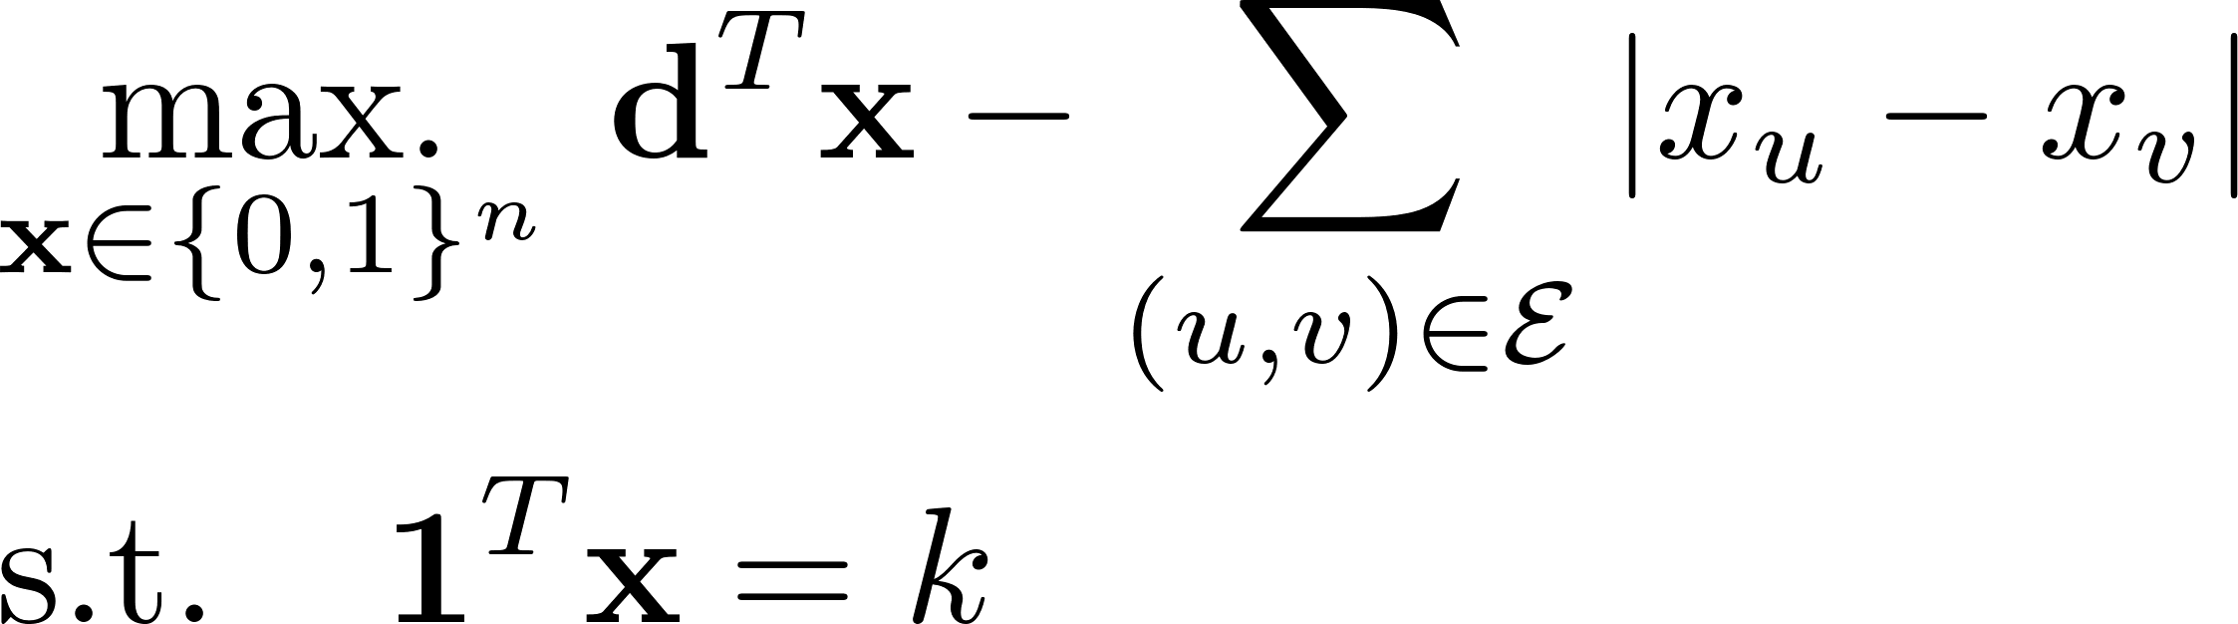
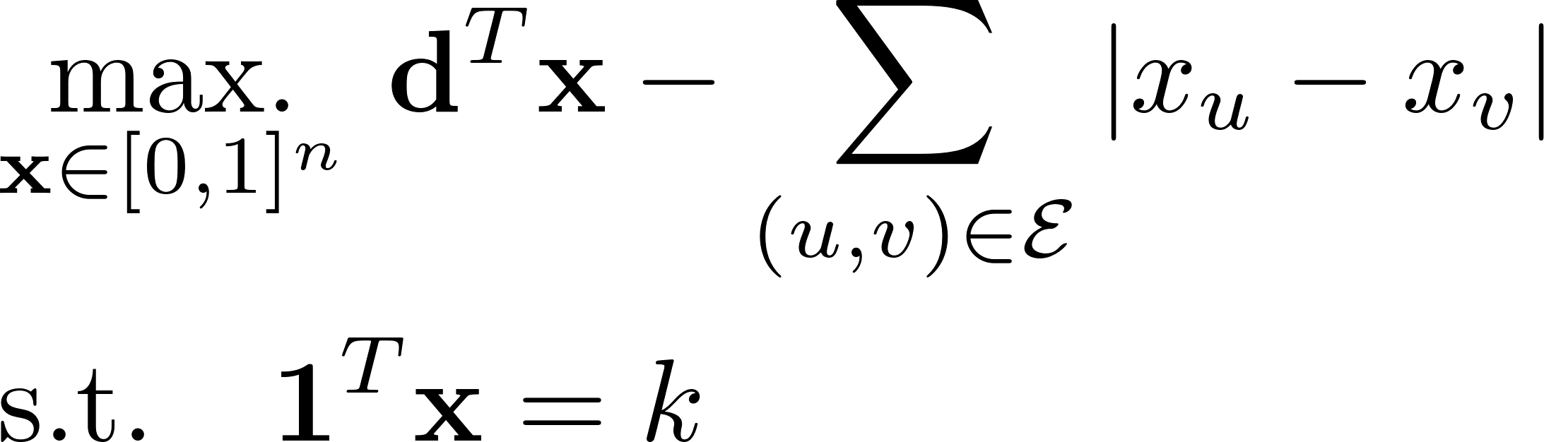
New relaxation: Main idea
Equivalent reformulation of DkS:
Relax discrete constraints
A new convex relaxation for DkS
What’s so special about it?
Graph total-variation

Slide 9
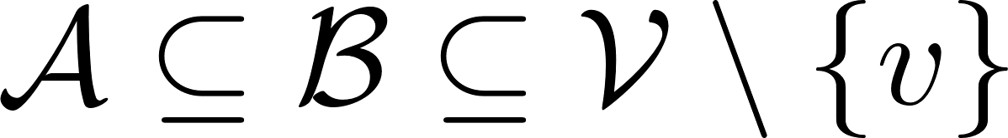


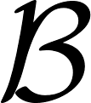
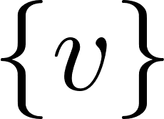
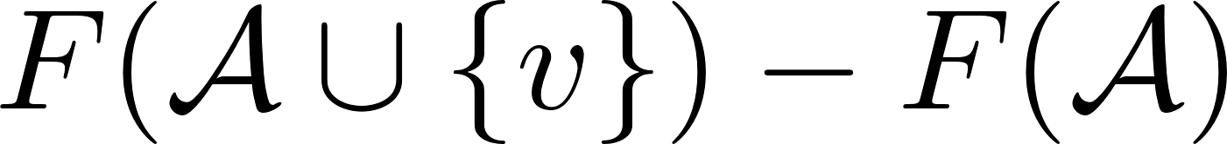

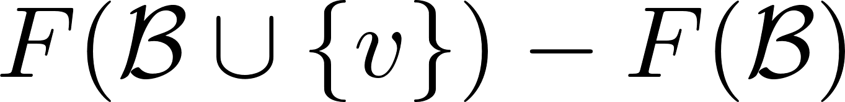
Submodularity and DkS
Claim: Quadratic cost function of DkS is submodular
Submodularity: For all
What is the link to convexity?
A diminishing returns property

Slide 10
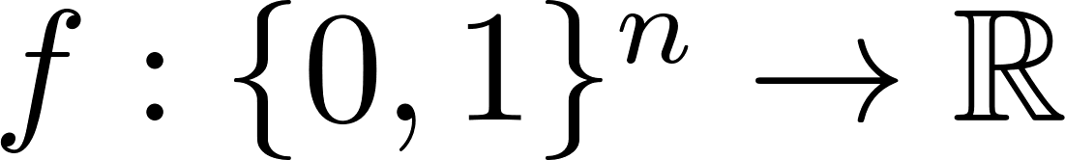
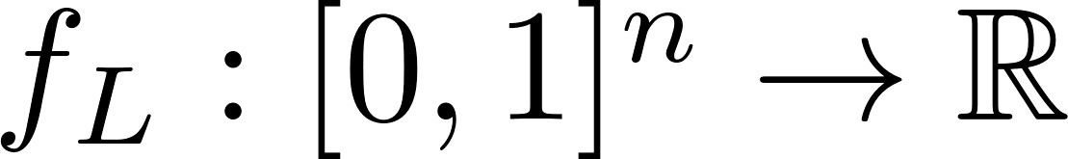
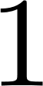

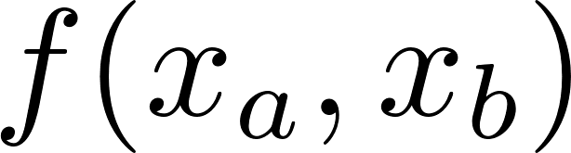
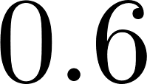
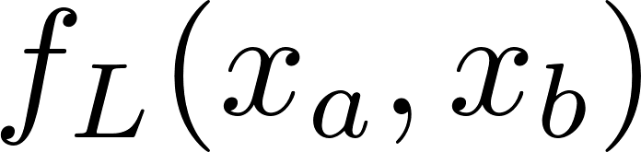

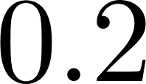
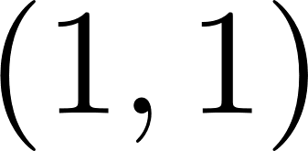
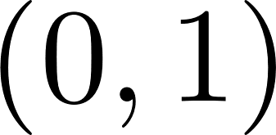
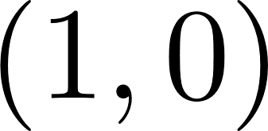
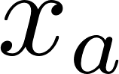
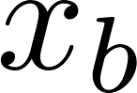
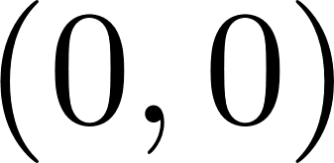
The Lovasz Extension
Key Fact:
Every submodular function possesses a continuous, convex extension [Lovasz 1983]
Tightest convex under-estimator of the submodular function (in a certain sense)
What is the Lovasz Extension for DkS?

Slide 11
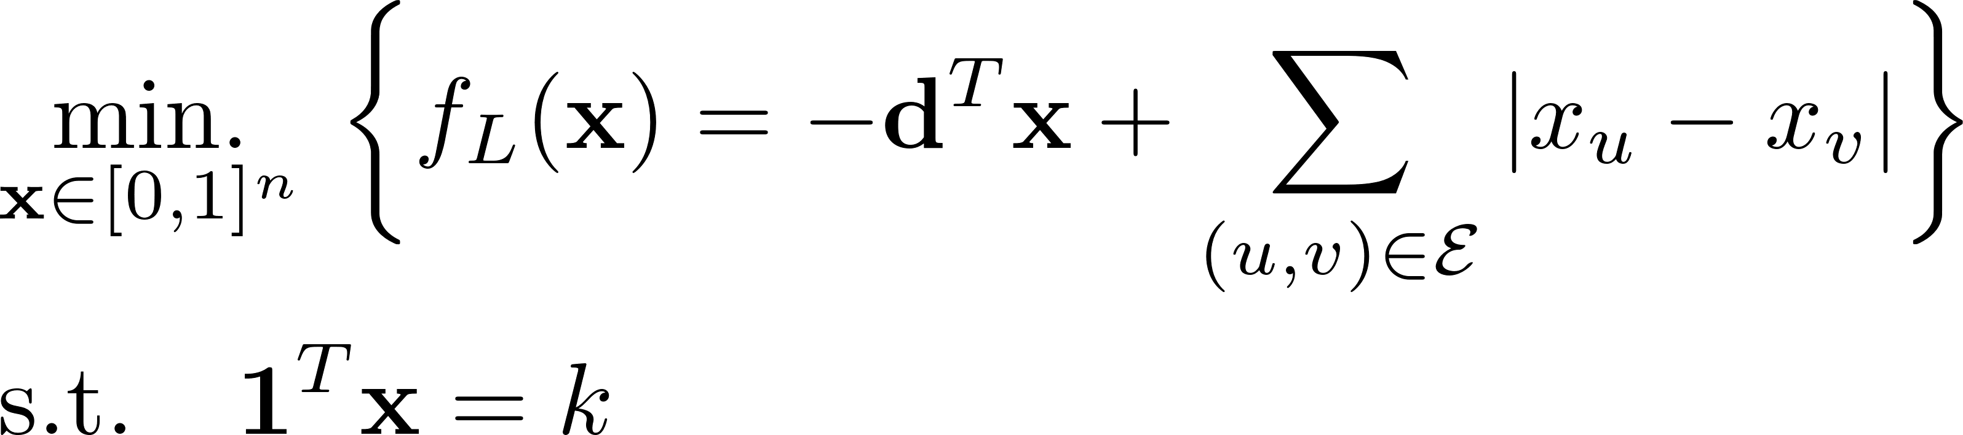
The Lovasz Extension for DkS
Main result: The Lovasz extension of the submodular cost function of DkS is:
The L-relaxation
Corresponds to minimizing the Lovasz extension over the convex hull of the discrete sum-to-k constraints
How to solve at scale?

Slide 12
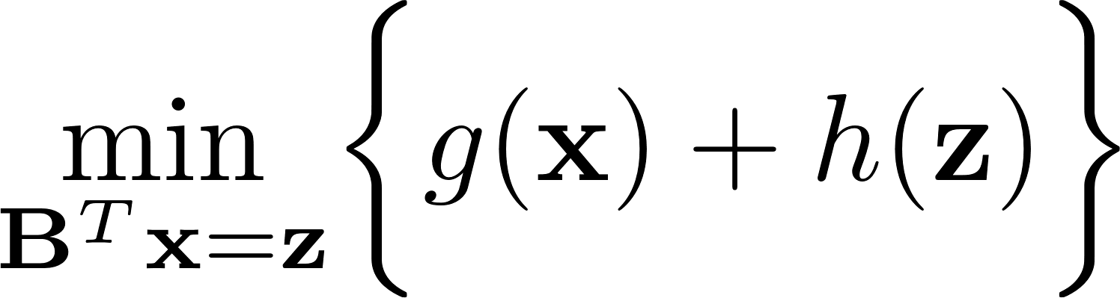
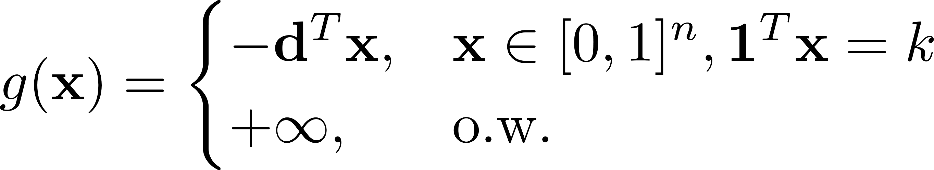
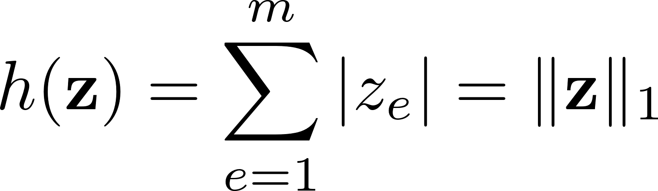
Solving the L-relaxation
Challenges:
Non-differentiable, lack of strong convexity
Slow convergence using subgradient methods
Solution: Express L-relaxation as
Apply Linearized-ADMM [Condat 2014]
where:

Slide 13
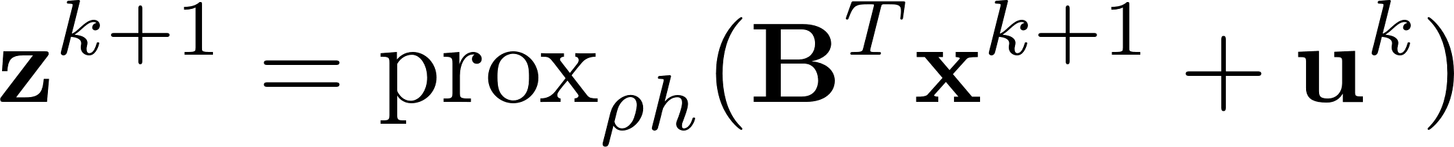
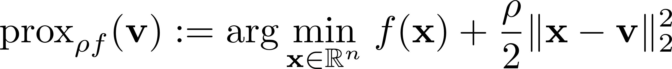
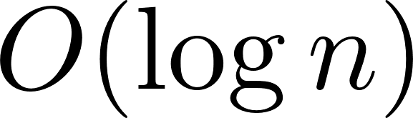
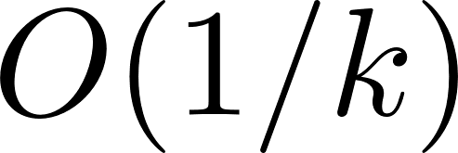
Solving the L-relaxation
L-ADMM updates:
Note:
Complexity of updates:
x-update: Bisection search (requires at most steps)
z-update: Soft-thresholding (closed-form)
L-ADMM guaranteed to converge at rate
Proximal operator of a convex function

Slide 14
Experimental setup
Our approach: Use L-ADMM to solve L-relaxation
Obtain final solution via
Projection onto discrete set
Last mile refinement using Frank-Wolfe (FW) [Frank-Wolfe 1956]
Baselines:
Greedy algorithm [Feige et al. 2001]
Truncated Power Method (TPM) [Yuan-Zhang 2013]
Use ADMM initialization
Rank-1 Binary Principal component [Papailiopoulos et al. 2014]
Use edge-density upper-bound as benchmark
Performance metric:
Edge-density = # edges induced by subgraph
# edges in k-clique

Slide 15
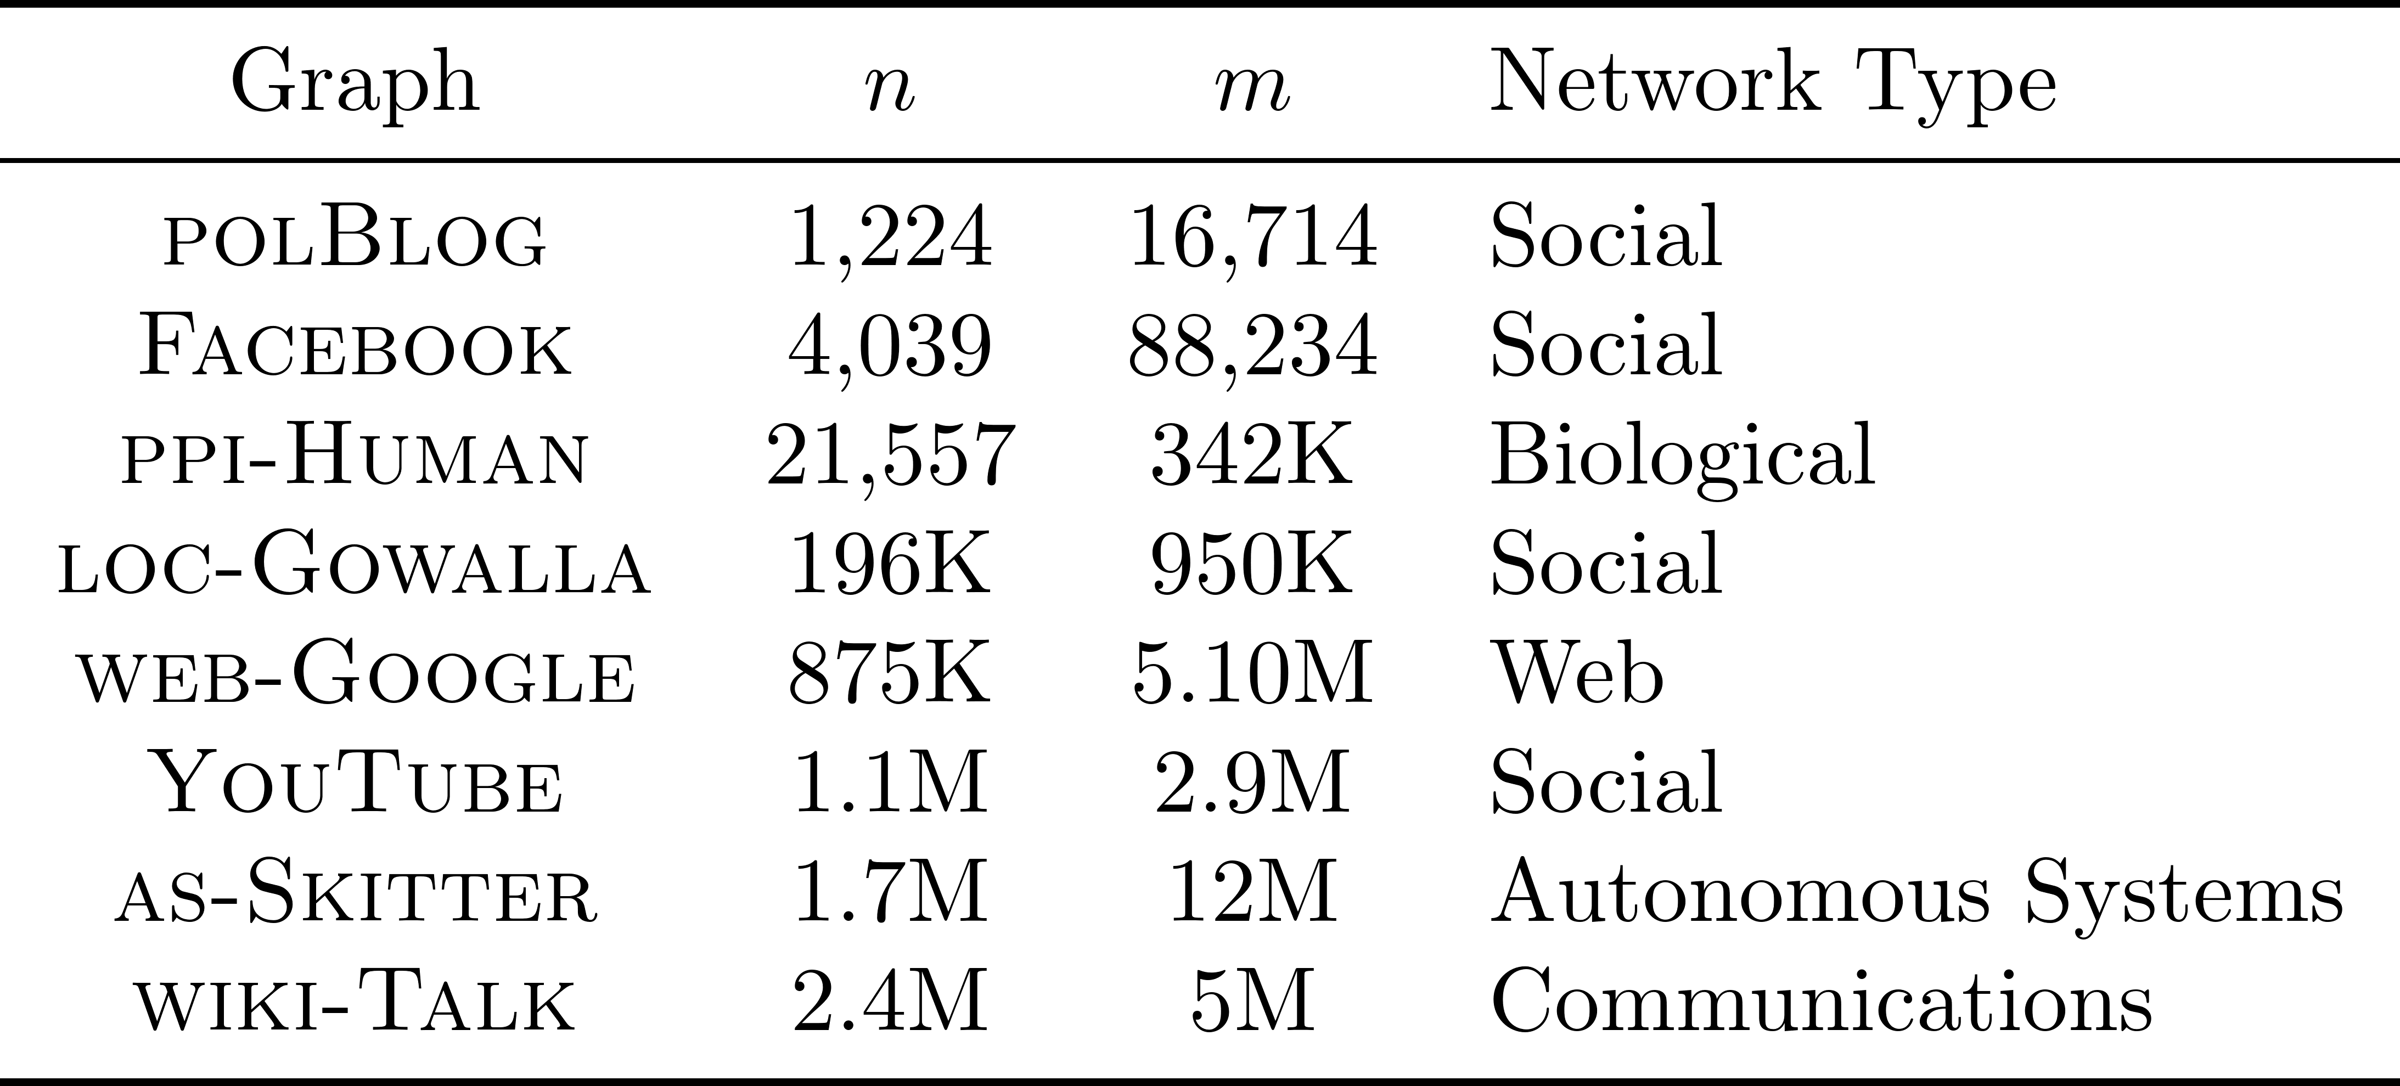
Experiments
Datasets: Obtained from SNAP

Slide 16
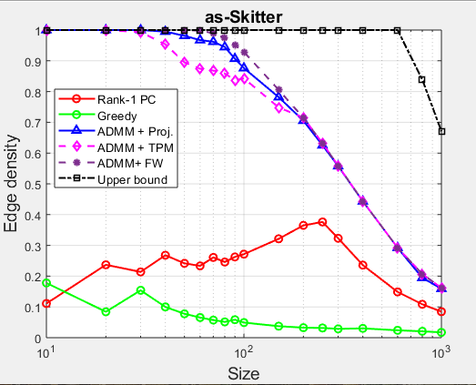
Results
Network: AS-Skitter (n = 1.7M, m = 12M)
Our approach attains state-of-the-art performance

Slide 17
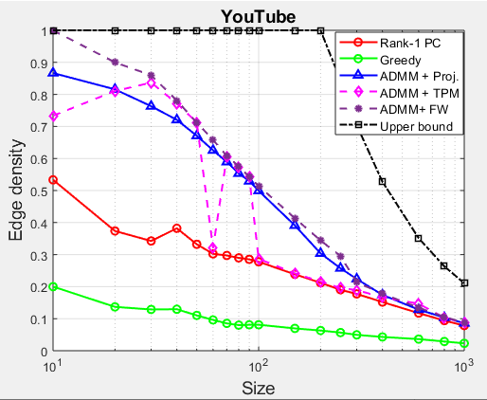
Results
Network: YouTube (n = 1.1M, m = 2.9M)
Our approach attains state-of-the-art performance

Slide 18
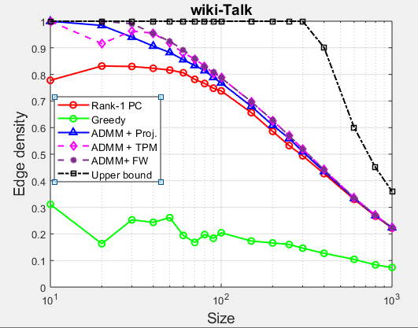
Results
Network: wiki-Talk (n = 2M, m = 5M)
Our approach attains state-of-the-art performance

Slide 19
Conclusions
DkS via the lens of submodularity:
A new convex relaxation for DkS
Uses Lovasz extension of submodular cost function
Scalable ADMM-based algorithm
Produces high-quality results on real-graphs
An effective tool for exploring the subgraph density-size trade-off
Future Work:
Additional theoretical analysis
Extensions to account for higher-order motif structure

Slide 20
Thank you!

